Slide 1
Noise analysis of Spheroids (more specific the better)
Date
Name
Bleris Lab

Slide 2
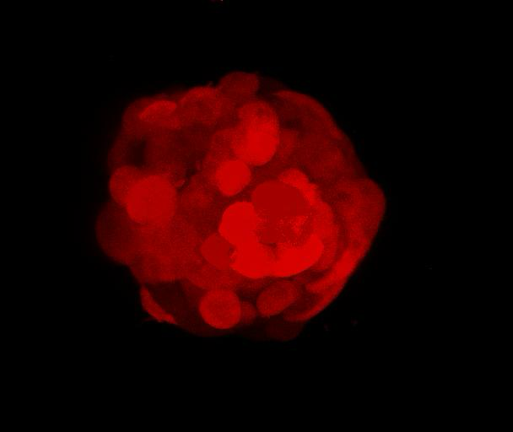
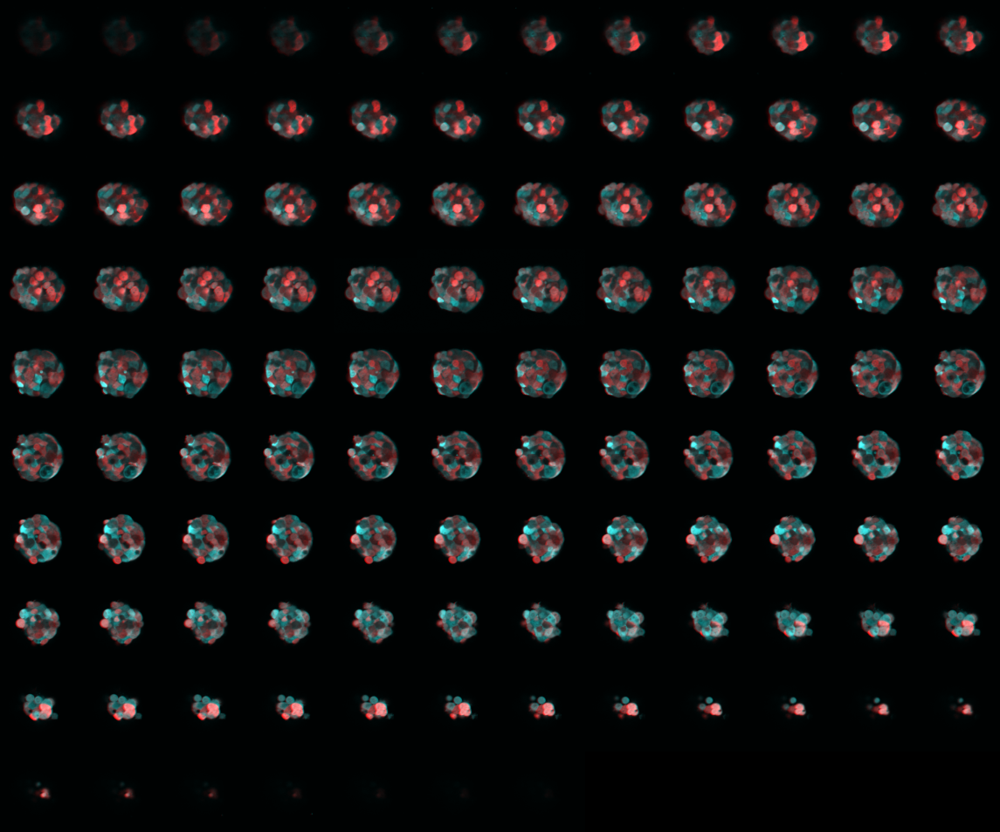
Spheroid data
115 slices
Analysis on 12-80
What color?
What did we use / not use

Slide 3
Goal / hypothesis
Decompose total noise into extrinsic and intrinsic noise in a segmented fluorescence image of the spheroid
Hypothesis:
Extrinsic noise is different based on location
Unsure about intrinsic noise

Slide 4
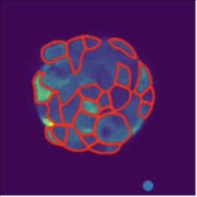
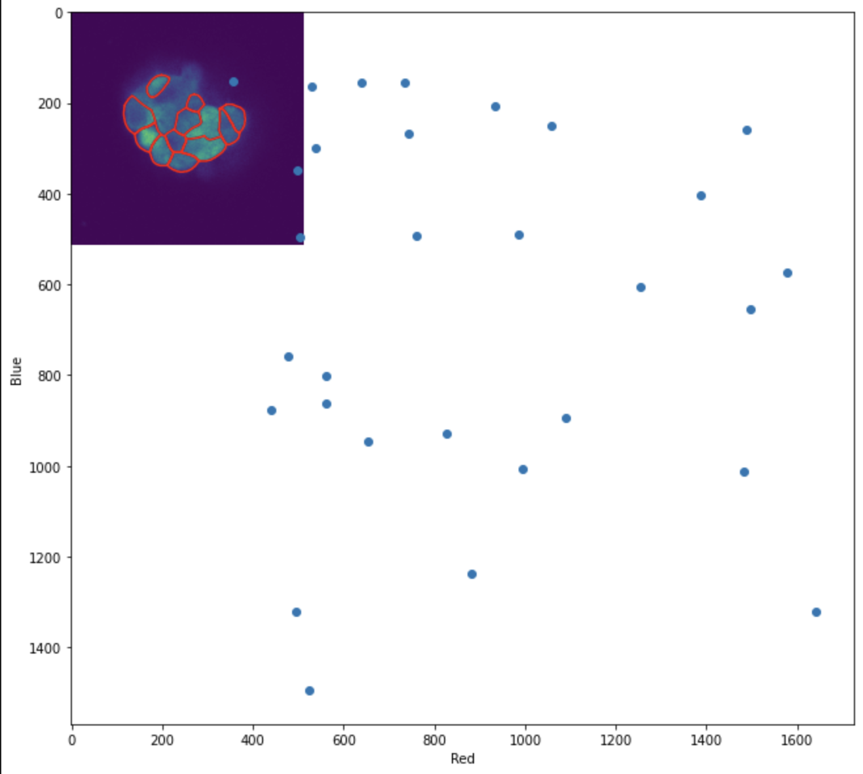
Process overview
1. Segmentation
2. Calculate mean for each segmented cell
3. Scatter plot for visualization
4. Intrinsic and extrinsic noise calculation

Slide 5

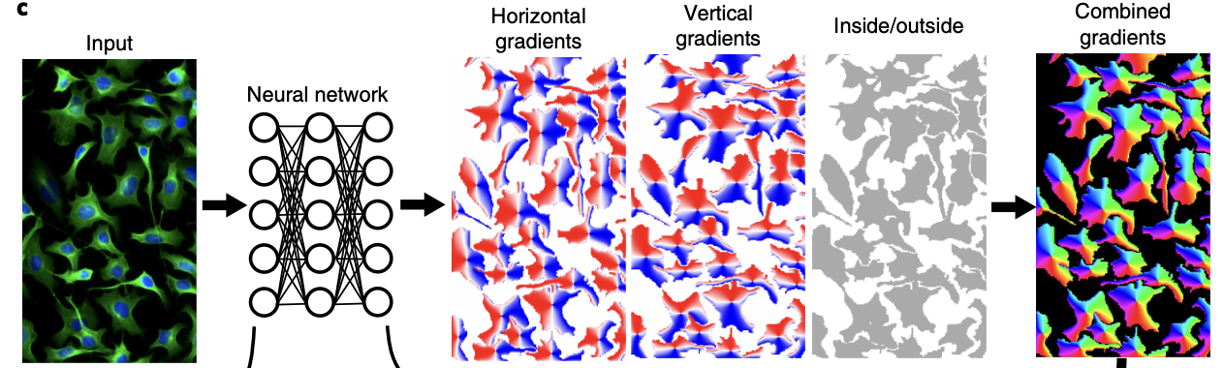
1. Segment
Cellpose algorithm (Stringer et al. Nature Methods 2021?)
Outputs the boundaries of different cells

Slide 6
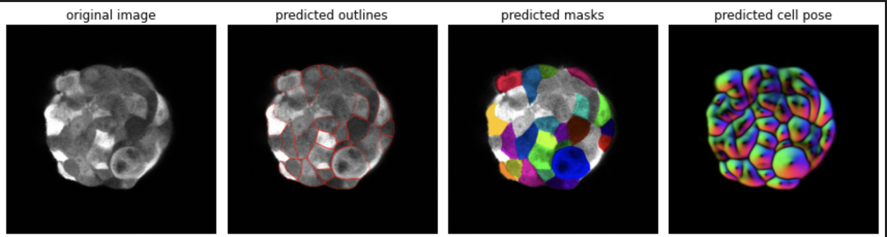
Segment
Cellpose algorithm
Outputs the boundaries of different cells

Slide 7
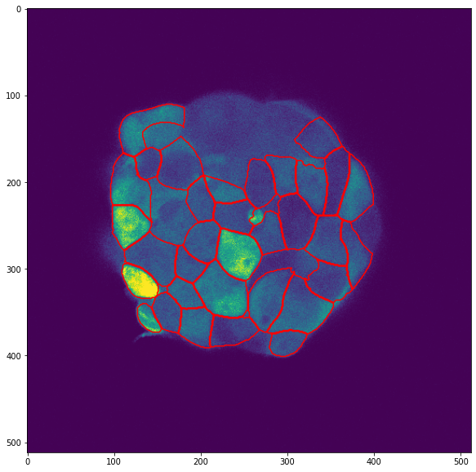
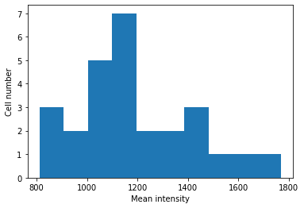
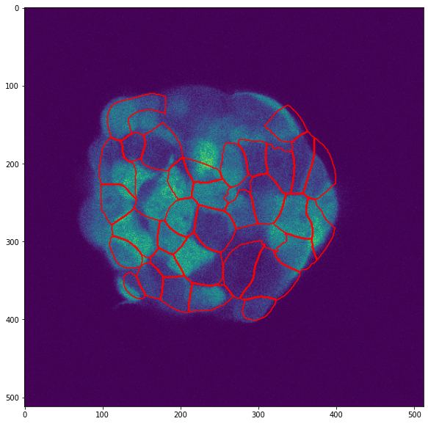
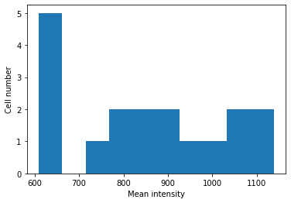
Mean intensity histogram
Mean CFP expression
Slice #3X
Count
Mean mKate2 expression
Notes:
Blue left, red right

Slide 8
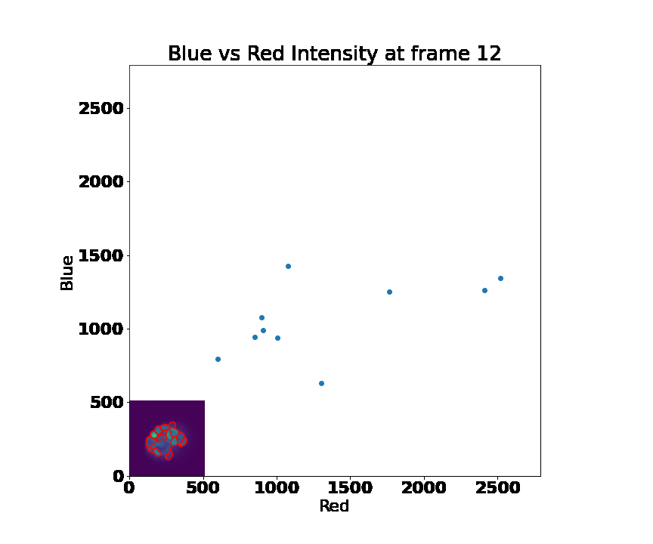
Scatter plot for visualization
Mean CFP vs Mean mKate2

Slide 9
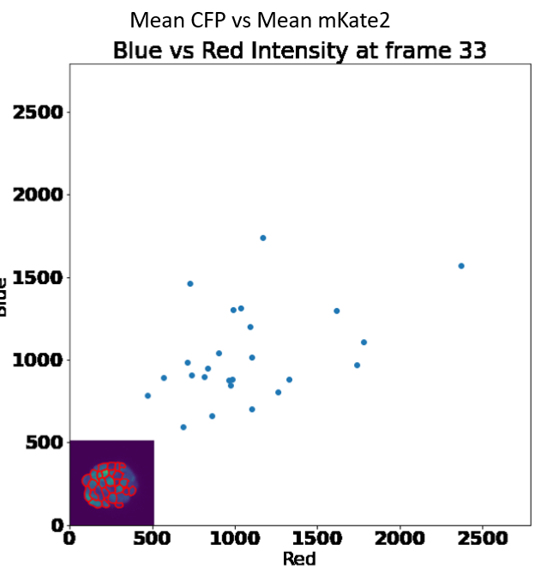
Noise decomposition
**Show formula used
Extrinsic noise
Extrinsic noise
Notes:
Blue left, red right

Slide 10
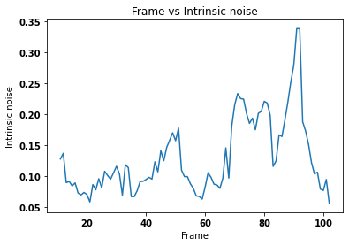
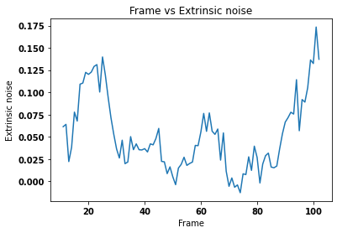
Intrinsic and extrinsic noise calculation
Notes:
The ends of the extrinsic noise being high could be because the segmentation is circling ones that are all black as well as the middle one with high expression.

Slide 11
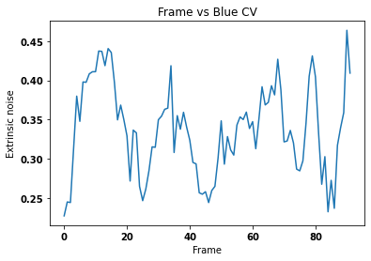
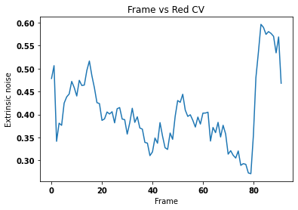
CV of expression vs Frame

